Slide 1
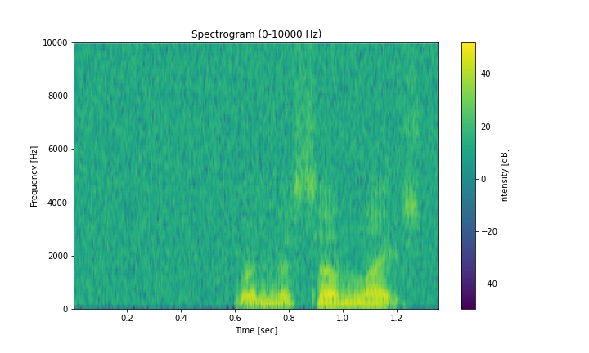
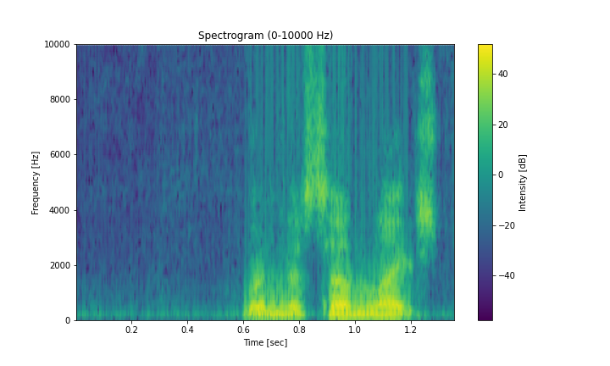
Reduction
Reduction
local attention
Conv 3x3
x₁
Codebook
Conv 3x3
e₁₁,...,e_{N1}
x₂
S
e₁₂,...,e_{N2}
Expansion
...
x₁
...
e₁₁,...,e_{N1}
FC
Expansion
x_{k}
x₂
S
e₁₂,...,e_{N2}
FC
Conv 3x3
Key
...
e_{1K},...,e_{NK}
...
Conv 3x3
x_{k}
Value
e_{1K},...,e_{NK}
Feature
Interaction
BN-ReLU
Key
Value
BN-ReLU
BN-ReLU
Conv5×5
Conv5×5
BN-ReLU
GroupNorm
GroupNorm
GroupNorm
GroupNorm
Depthwise
Convolution
Channel
MLP
Depthwise
Convolution
Channel
MLP
Channel
Scaling
Channel
Scaling
Channel
Scaling
Feature Interaction
Channel
Scaling
GroupNorm
Reduction
=
Reduction
BatchNorm
GroupNorm
GroupNorm
BN-ReLU
Reduction
GroupNorm
Depthwise
Convolution
Conv5×5
Conv 3x3
Relu
Channel
MLP
Depthwise
Convolution
Conv5×5
Conv 3x3
Conv 3x3
Channel
MLP
Channel
Scaling
BN-ReLU
Expansion
Mean
Channel
Scaling
Channel
Scaling
Expansion
Expansion
Channel
Scaling
Conv 3x3
FC
Conv 3x3
FC
BN-ReLU
BN-ReLU
x₁
local attention
e₁₁,...,e_{N1}
Feature
Interaction
Feature Interaction
x₂
S
e₁₂,...,e_{N2}
...
...
x_{k}
e_{1K},...,e_{NK}
Input X
Key
Value
Conv1×1
Avg
Conv5×5
Concat
Broadcasting
复数全局
多层感知器
频谱长程依赖交互
BN-ReLU
频谱局部依赖交互
复数
局部注意力
通道加法
实部特征提取
虚部特征提取
全连接层
通道维度拼接
缩放因子
通道平均池化
通道乘法
通道加法

